Slide 1
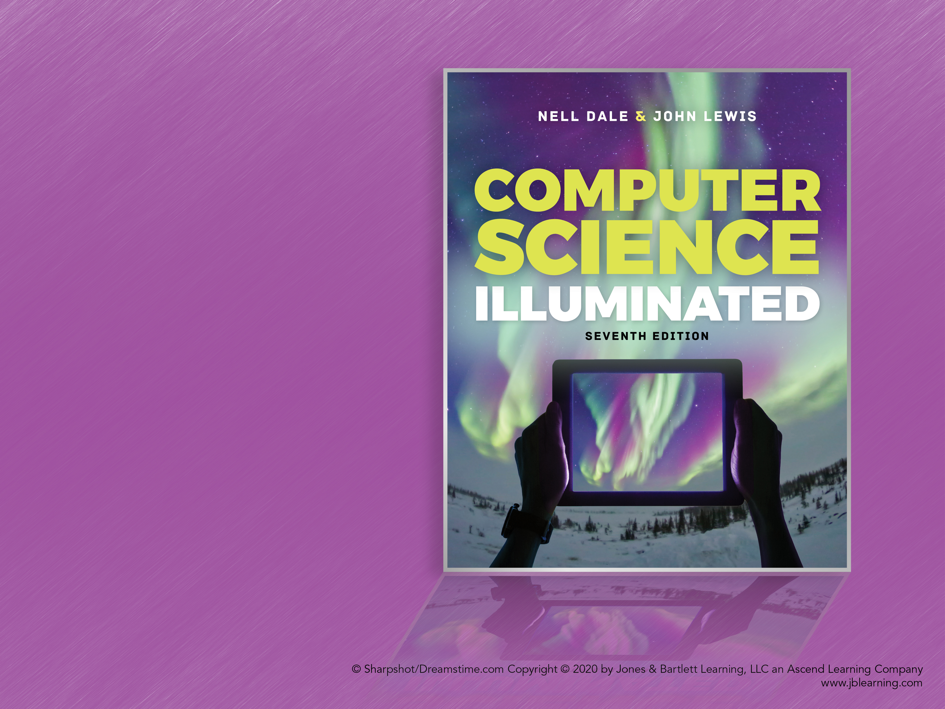
Chapter 18
Limitations of Computing

Slide 2
Chapter Goals (1 of 2)
Describe the limits that the hardware places on the solution to computing problems
Discuss how the finiteness of the computer impacts the solutions to numeric problems
Discuss ways to ensure that errors in data transmission are detected
Describe the limits that the software places on the solutions to computing problems

Slide 3
Chapter Goals (2 of 2)
Discuss ways to build better software
Describe the limits inherent in computable problems themselves
Discuss the continuum of problem complexity from problems in Class P to problems that are unsolvable

Slide 4
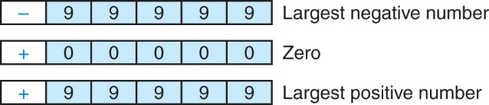
Limits on Arithmetic (1 of 9)
Precision
The maximum number of significant digits that can be represented
With 5-digit precision, the range of the numbers we can represent is –99,999 through +99,999

Slide 5
Limits on Arithmetic (2 of 9)
What happens if we allow one of these digits (let's say the leftmost one, in red) to represent an exponent?
For example
represents the number +3,245 * 10³

Slide 6
Limits on Arithmetic (3 of 9)
The range of numbers we can now represent is much larger
–9,999 * 10⁹ to +9,999 * 10⁹
but we can represent only four significant digits
Significant Digits
Those digits that begin with the first nonzero digit on the left and end with the last nonzero digit on the right

Slide 7
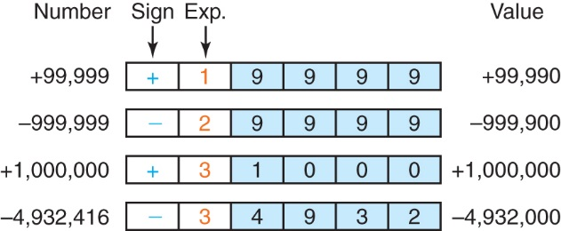
Limits on Arithmetic (4 of 9)
The four leftmost digits are correct, and the balance of the digits are assumed to be zero
We lose the rightmost, or least significant, digits

Slide 8
Limits on Arithmetic (5 of 9)
To represent real numbers, we extend our coding scheme to represent negative exponents
For example
4,394 * 10^{–2} = 43.94 or 22 * 10^{–4} = 0.0022

Slide 9
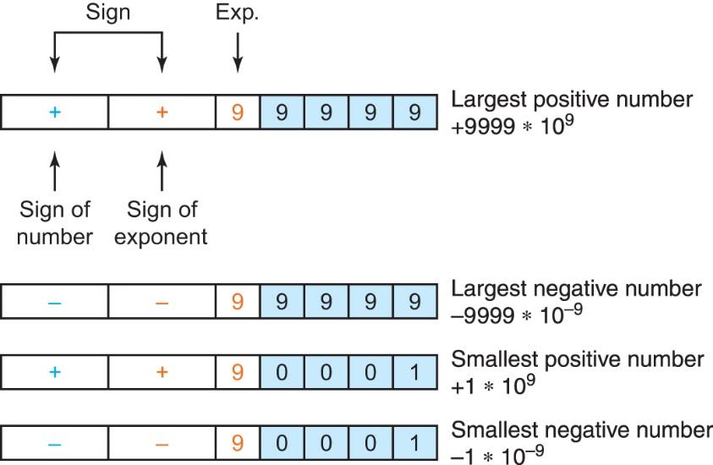
Limits on Arithmetic (6 of 9)
Let the current sign be the sign of the exponent and add a sign to the left to be the sign of the number itself
What is the largest negative number?
The smallest positive number?
The smallest negative number?

Slide 10
Limits on Arithmetic (7 of 9)
Representational Error or Round-off Error
An arithmetic error caused by the fact that the precision of the result of an arithmetic operation is greater than the precision of the machine
Underflow
Results of a calculation are too small to represent in a given machine
Overflow
Results of a calculation are too large to represent in a given machine
Cancellation Error
A loss of accuracy during addition or subtraction of numbers of widely differing sizes, due to the limits of precision

Slide 11
Limits on Arithmetic (8 of 9)
There are limitations imposed by the hardware on the representations of both integer numbers and real numbers
If the word length is 32 bits, the range of integer numbers that can be represented is 22,147,483,648 to 2,147,483,647
There are software solutions, however, that allow programs to overcome these limitations
For example, we could represent a very large number as a list of smaller numbers

Slide 12
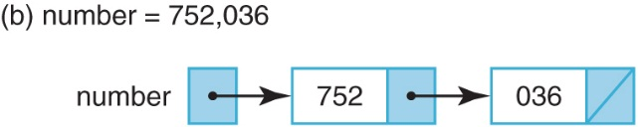
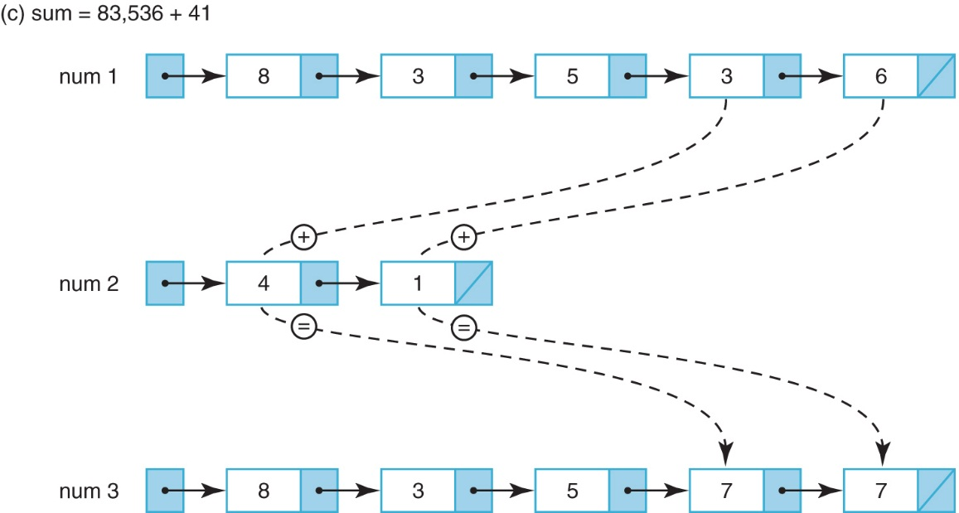
Limits on Arithmetic (9 of 9)
Representing very large numbers

Slide 13
Limits on Components
Although most errors are caused by software, hardware components do fail
Have you ever had a hardware failure?

Slide 14
Limits on Communications (1 of 4)
Error-Detecting Codes
Techniques to determine if an error has occurred during the transmission of data and then alert the system
Error-Correcting Codes
Error-detecting codes that detect an error has occurred and try to determine the correct value

Slide 15
Limits on Communications (2 of 4)
Parity Bit
An extra bit that is associated with each byte, used to ensure that the number of 1 bits in a 9-bit value (byte plus parity bit) is odd (or even) across all bytes
Parity bits are used to detect that an error has occurred between the storing and retrieving of a byte or the sending and receiving of a byte

Slide 16
Limits on Communications (3 of 4)
Odd parity requires that the number of 1s in a byte plus the parity bit be odd
For example
If a byte contains the pattern 11001100, the parity bit would be 1, thus giving an odd number of 1s
If the pattern were 11110001, the parity bit would be 0, giving an odd number of 1s
Even parity uses the same scheme, but the number of 1 bits must be even

Slide 17
Limits on Communications (4 of 4)
Check digits
A software variation of the same scheme is to sum the individual digits of a number and store the unit's digit of that sum with the number
For example, given the number 34376, the sum of the digits is 23, so the number would be stored as 34376–3
Error-correcting codes
If enough information about a byte or number is kept, it is possible to deduce what an incorrect bit or digit must be

Slide 18
Complexity of Software
Commercial software contains errors
The problem is complexity
Software testing can demonstrate the presence of bugs, but cannot demonstrate their absence
As we find problems and fix them, we raise our confidence that the software performs as it should
But we can never guarantee that all bugs have been removed

Slide 19
Software Engineering (1 of 4)
Remember the four stages of computer problem solving?
Write the specifications
Develop the algorithm
Implement the algorithm
Maintain the program
Moving from small, well-defined tasks to large software projects, we need to add two extra layers on top of these: software requirements and specifications

Slide 20
Software Engineering (2 of 4)
Software Requirements
A statement of what is to be provided by a computer system or software product
Software Specifications
A detailed description of the function, inputs, processing, outputs, and special features of a software product; it provides the information needed to design and implement the software

Slide 21
Software Engineering (3 of 4)
Testing techniques have been a running thread throughout this book
They are mentioned here again as part of software engineering
Can you define walk-throughs and inspections?

Slide 22
Software Engineering (4 of 4)
Use of software engineering techniques can reduce errors, but they will occur
A guideline for the number of errors per lines of code that can be expected:
Standard software: 25 bugs per 1,000 lines of program
Good software: 2 errors per 1,000 lines
Space Shuttle software: < 1 error per 10,000 lines

Slide 23
Formal Verification
The verification of program correctness, independent of data testing, is an important area of theoretical computer science research
Formal methods have been used successfully in verifying the correctness of computer chips
It is hoped that success with formal verification techniques at the hardware level can lead eventually to success at the software level

Slide 24
Open Source Movement
Pre-1970, source code came bundled with the computer
Programmers modified it and shared their improvements
Then companies started withholding source code
With the growth of the Internet, programmers have once again begun to collaborate, often with a “benevolent dictator” and peer review
The Linux operating system is the best known example of an open source project
Now many companies consider open source development to be one of several design choices
Some studies show that open source software has lower defect rates than commercial software
One open source defect drew a lot of attention in 2014: the Heartbleed vulnerability in OpenSSL

Slide 25
Notorious Software Errors (1 of 2)
AT&T Down for Nine Hours
In January of 1990, AT&T's long-distance telephone network came to a screeching halt for 9 hours because of a software error in an upgrade to the electronic switching systems

Slide 26
Notorious Software Errors (2 of 2)
Mariner 1 Venus Probe
This probe, launched in July of 1962, veered off course almost immediately and had to be destroyed
The problem was traced to the following line of Fortran code:
DO 5 K = 1. 3
The period should have been a comma.
An $18.5 million space exploration vehicle was lost because of this typographical error

Slide 27
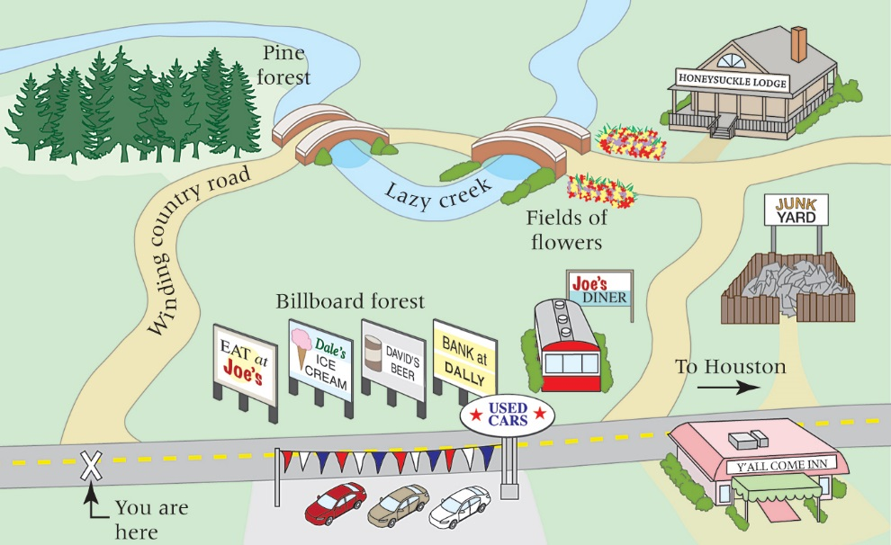
Comparing Algorithms
Equally valid solutions to the same problem

Slide 28
Big-O Analysis (1 of 8)
We use a special notation to compare algorithms
Big-O Notation
A notation that expresses computing time (complexity) as the term in a function that increases most rapidly relative to the size of a problem

Slide 29
Big-O Analysis (2 of 8)
Function of size factor N:
f(N) = N⁴ + 100N² + 10N + 50
Then f(N) is of order N⁴—or, in Big-O notation, O(N⁴).
For large values of N, N⁴ is so much larger than 50, 10N, or even 100N² that we can ignore these other terms

Slide 30
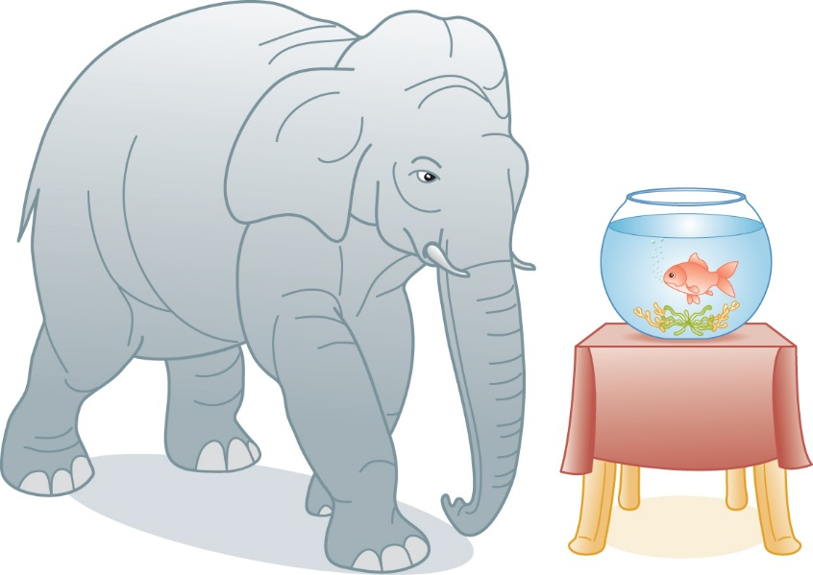
Big-O Analysis (3 of 8)
If you're buying a elephant and a goldfish from one of
two vendors, you only need to compare the price of
the elephant.
The price of the goldfish pales in comparison.
The price of a goldfish pales in comparison to the price of an elephant

Slide 31
Big-O Analysis (4 of 8)
Common Orders of Magnitude
O(1) is called bounded time
Assigning a value to the ith element in an array of N elements
O(log₂N) is called logarithmic time
Algorithms that successively cut the amount of data to be processed in half at each step typically fall into this category
Finding a value in a list of sorted elements using the binary search algorithm is O(log₂N)

Slide 32
Big-O Analysis (5 of 8)
O(N) is called linear time
Printing all the elements in a list of N elements is O(N)
O(N log₂N)
Algorithms of this type typically involve applying a logarithmic algorithm N times
The better sorting algorithms, such as Quicksort, Heapsort, and Mergesort, have N log₂N complexity

Slide 33
Big-O Analysis (6 of 8)
O(N²) is called quadratic time
Algorithms of this type typically involve applying a linear algorithm N times. Most simple sorting algorithms are O(N²) algorithms
O(2^{N}) is called exponential time
O(N!) is called factorial time
The traveling salesperson graph algorithm is a factorial time algorithm

Slide 34
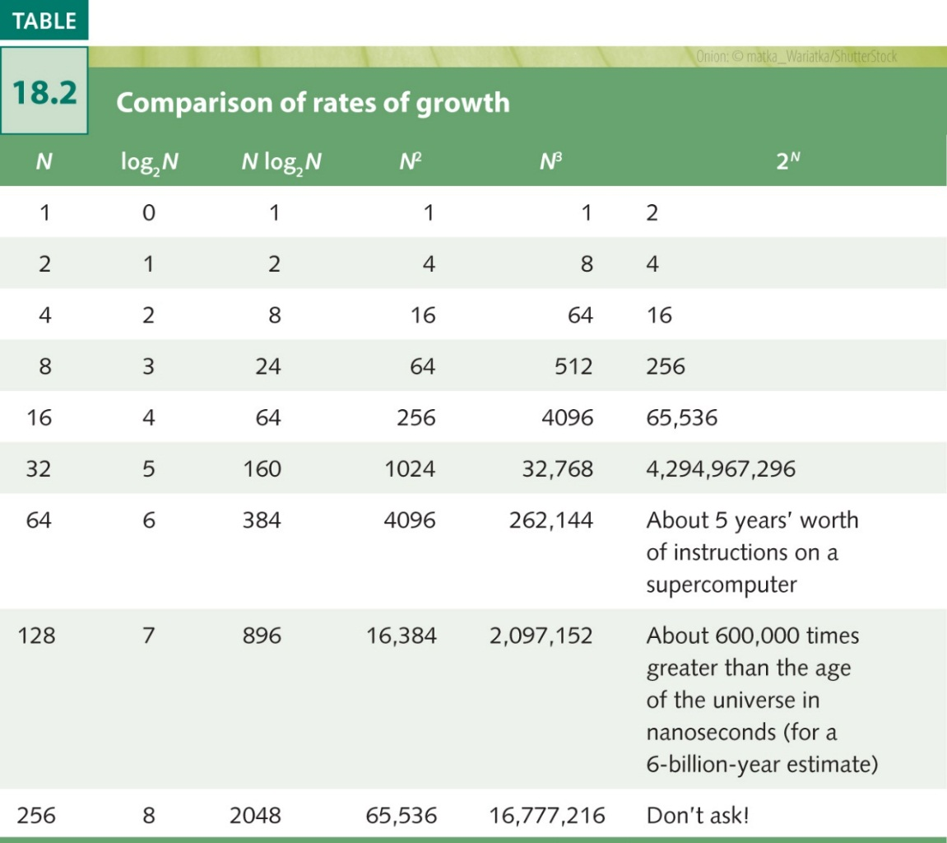
Big-O Analysis (7 of 8)
Comparison rates of growth

Slide 35
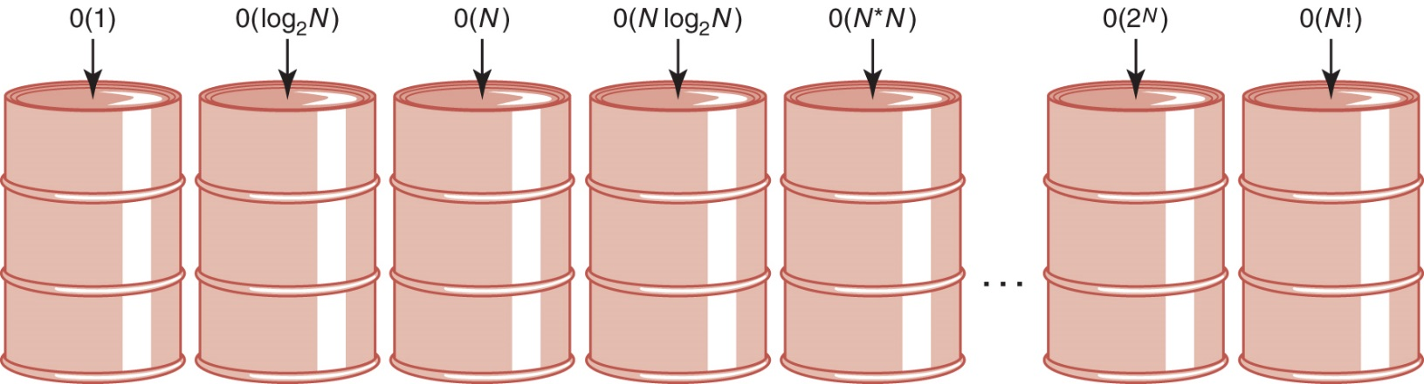
Big-O Analysis (8 of 8)
Orders of complexity

Slide 36
Turing Machines (1 of 2)
Turing Machine
A model Turing machine was developed in the 1930s and consists of a control unit with a read/write head that can read and write symbols on an infinite tape

Slide 37
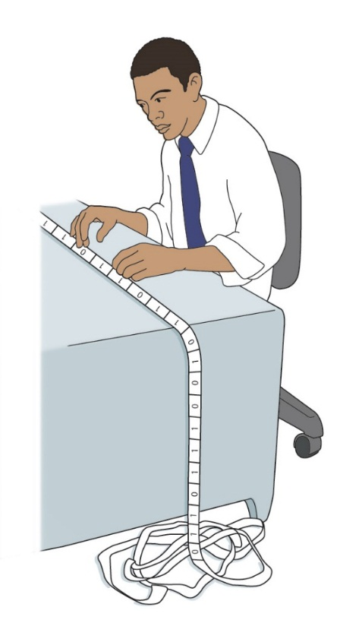
Turing Machines (2 of 2)
Why is such a simple machine (model) of any importance?
It is widely accepted that anything that is intuitively computable can be computed by a Turing machine
If we can find a problem for which a Turing-machine solution can be proven not to exist, then the problem must be unsolvable
Turing machine processing

Slide 38
Halting Problem (1 of 6)
The Halting Problem
Given a program and an input to the program, determine if the given program will eventually stop with this particular input
If the program doesn't stop, then it is in an infinite loop and this problem is unsolvable

Slide 39
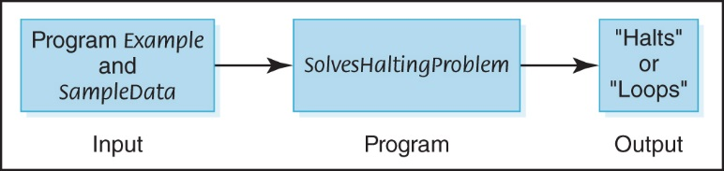
Halting Problem (2 of 6)
Assume that there exists a Turing-machine program, called SolvesHaltingProblem, that determines for any program Example and input SampleData whether program Example halts given input SampleData
Proposed program for solving the halting problem

Slide 40
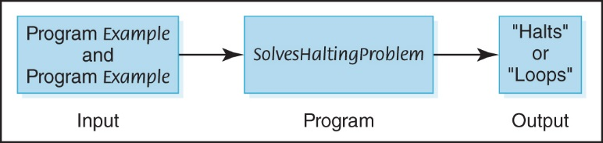
Halting Problem (3 of 6)
Proposed program for solving the halting problem

Slide 41
Halting Problem (4 of 6)
Now let's construct a new program, NewProgram, that takes program Example as both program and data…
And uses NewProgram the algorithm from SolvesHaltingProblem to write “Halts” if Example halts and “Loops” if it does not halt

Slide 42
Halting Problem (5 of 6)
Let's now apply program SolvesHaltingProblem to NewProgram, using NewProgram as data
If SolvesHaltingProblem prints “Halts”, program NewProgram goes into an infinite loop
If SolvesHaltingProblem prints “Loops”, program NewProgram prints “Halts” and stops
In either case, SolvesHaltingProblem gives the wrong answer
Because SolvesHaltingProblem gives the wrong answer in at least one case, it doesn't work on all cases

Slide 43
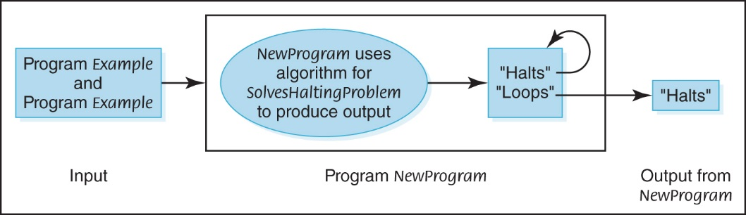
Halting Problem (6 of 6)
Construction of NewProgram

Slide 44
Classification of Algorithms (1 of 3)
Polynomial-Time Algorithms
Algorithms whose order of magnitude can be expressed as a polynomial in the size of the problem
Class P
Problems that can be solved with one processor in polynomial time
NP-Complete Problems
Problems that can be solved in polynomial time with as many processors as desired

Slide 45
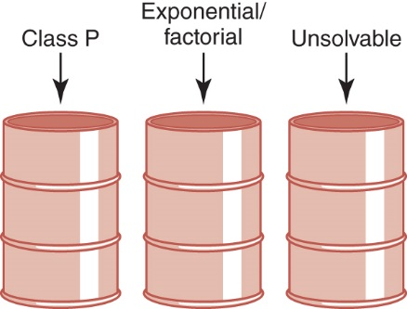
Classification of Algorithms (2 of 3)
Let's reorganize our bins, combining all polynomial algorithms in a bin labeled Class P
A reorganization of algorithm classifications

Slide 46
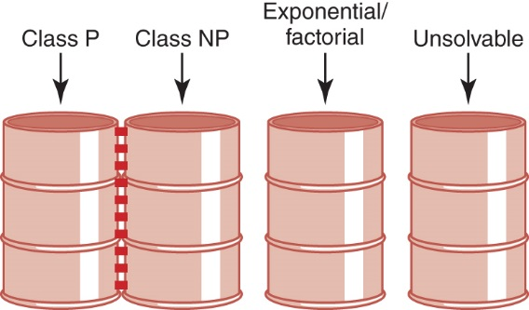
Classification of Algorithms (3 of 3)
Are Class
NP
problems
also in
Class P?
Adding Class NP

Slide 47
Ethical Issues
Therac-25
What were the Therac machines?
What happened to six patients?
What were the causes of the problems?
What lesson can be learned from this disaster?

Slide 48
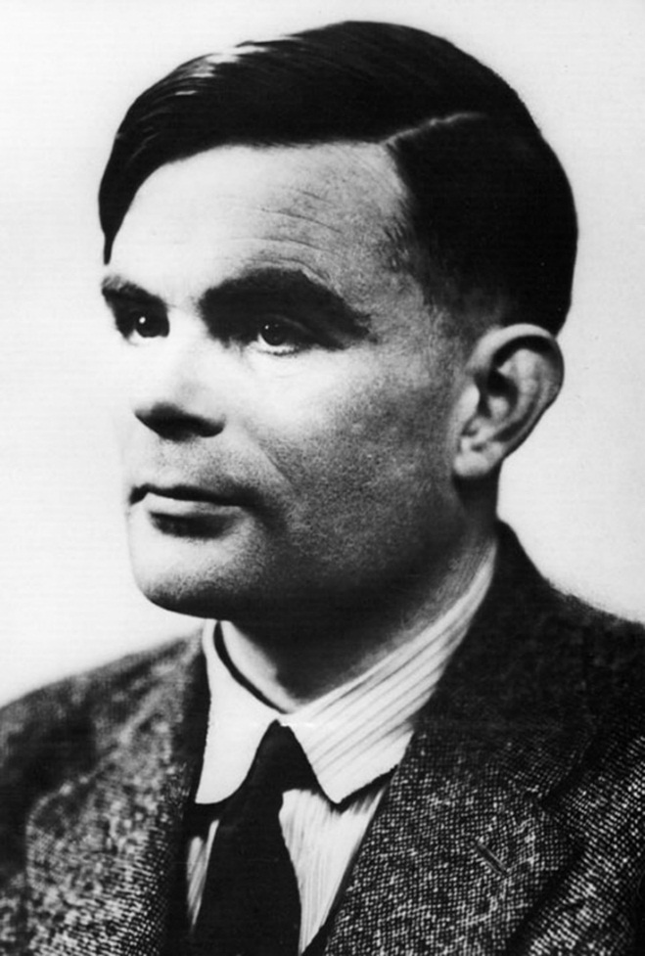
Who Am I?
What machine
and what award
are named
after me?
Why am I on
Time's list of
the 100 most
influential
persons in
the 20th century?
Why did I die
before my time?
© Pictorial Press Ltd./ Alamy Stock Photo

Slide 49
Do You Know?
Why did Julia Angwin ask if privacy has become a luxury in her New York Times opinion piece?
Why is it unwise to tweet about your vacation?
Watson is this, in addition to being a Jeopardy champion.
Which university had students hack into their graduate applications?
Why did Dijkstra criticize the use of the term "bugs”?
What is a micro-taggant? How is it used?
What is The Bletchley Circle?
Would you have responded to Capt. Roy's email?
What is the Traveling Salesman Problem?

